Slide 1
Innovative Treatment and Recovery Services
Illinois Department of Human Services,
Division of Substance Use Prevention and Recovery
And Division of Mental Health
Programs and Initiatives

Slide 2
What you are going to hear today:
Stephanie Frank – Interagency Collaborations, Deflection, Permanent Supportive Housing,
Dr. Nicky Gastala – Medication Assisted Recovery
Kim Sriner – Recovery Initiatives
Sherrine Peyton – Opioid Settlement Funding and Programs
Kellie Gage – Gambling Initiatives
Lee Ann Reinert – 988 and Crisis Infrastructure
Amanda Lake – Integrated Mental Health and Substance Use Services and Workforce Initiatives

Slide 3
IDHS/ SUPR’s mission
The mission of the Division of Substance Use Prevention and Recovery is to provide a recovery oriented system of care along the continuum of prevention, intervention, treatment and recovery support where individuals with SUD, those in recovery and those at risk are valued and treated with dignity and where stigma, accompanying attitudes, discrimination, and other barriers to recovery are eliminated.

Slide 4
Assessments
Individual Counseling
Group Counseling
SUD Withdrawal Management
Case Management
Recovery Support Services
Community Intervention (crisis intervention)
Medication Assisted Recovery
Recovery Housing
Naloxone/Narcan Distribution
Peer Doula Services
Enhanced Recovery Homes
Services
Supported
by
IDHS/SUPR

Slide 5
Inter-Agency Collaborations
Division of Mental Health
Governor’s Office
Illinois Housing Development Authority
Cannabis Regulation Oversight Office
Department of Children and Family Services
Department of Corrections
Division of Early Childhood
Illinois Gaming Board
Illinois State Police
Administrative Office of Illinois Courts
Illinois Criminal Justice Information Authority
Health and Human Services

Slide 6
Deflection is an initiative that provides individuals that come in contact with police an alternatives to being arrested. It gives law enforcement the discretion to deflect to substance use treatment and other services that address social determinates of health.
What is Deflection?

Slide 7
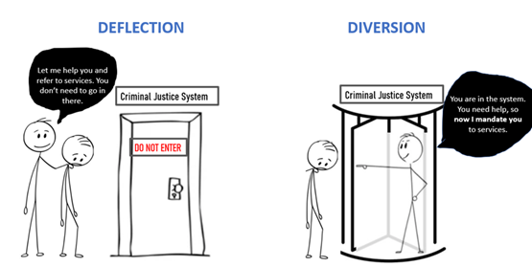

Slide 8
Deflection is:
An early upstream strategy
Prevention
Meeting people where they are
Centered in the community
Deflecting away from the criminal legal system
Guided by behavioral health with criminal legal system partnerships

Slide 9
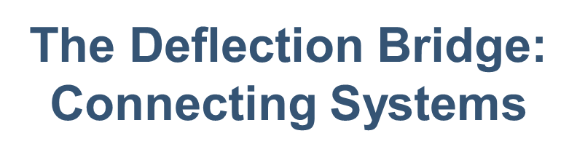


Referral/Placement
into Treatment
100% Identification & Screening
Monitoring & Reporting
Assessment
Recovery Support
Law Enforcement
Treatment System
Systems-Level: Case Management, Collaboration, Metrics
Community
Everybody Doing Their Best Work

Slide 10

The Six Pathways to Deflection
Self-Referral: Individual initiates contact with law enforcement for a treatment referral (without fear of arrest); preferably a warm handoff to treatment
Active Outreach: Deflection Team intentionally IDs or seeks individuals; a warm handoff is made to treatment, which engages individuals in treatment
Naloxone Plus: Engagement with treatment as part of an overdose response or DSM-V severe for opiates; tight integration with treatment, naloxone (individual too)
Officer/First Responder Referral: Law enforcement/FR initiates treatment engagement from a call for service or “on view”; no charges are filed
Officer Intervention Referral: Law enforcement (only) initiates treatment engagement from a call for service or “on view”; charges are held in abeyance or citations issued, with requirement for completion of treatment

Slide 11
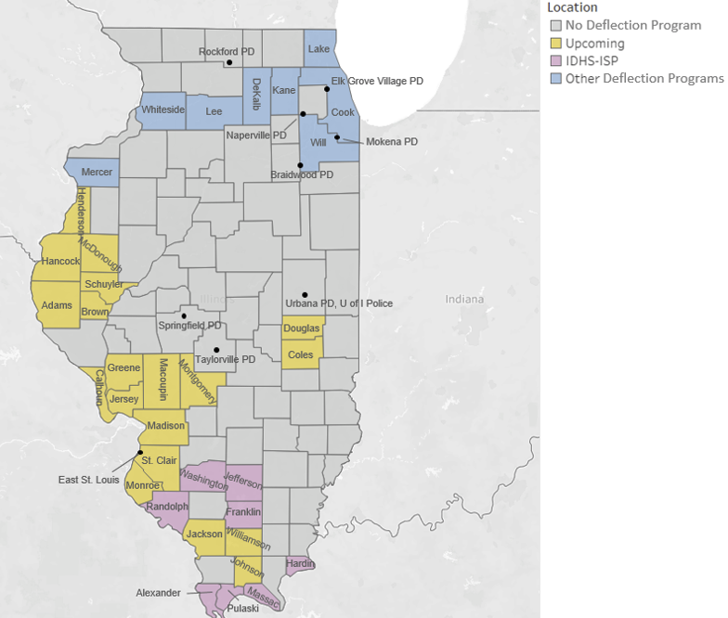
Map of Known IL Deflection Sites

Slide 12
Permanent Supportive Housing
Housing First – A person centered approach to housing that provides immediate access to housing without requiring substance use disorder treatment or mental health treatment. Housing First assumes that housing is a basic human right and that an individual has the right to chose their housing and their services when and if they want them.

Slide 13
Additional Principles of Supportive Housing
Participation is voluntary. Tenants cannot be evicted for not participating in services
Prospective tenants have a choice in housing
Housing is affordable with tenants paying no more than 30% of their income

Slide 14




Priority Populations for PSH
Women
Women with Children / Families
Young adults

Slide 15




Lowering Barriers to MOUD
Illinois Medication Assisted Recovery Telehealth Hotline
“MAR NOW”

Slide 16
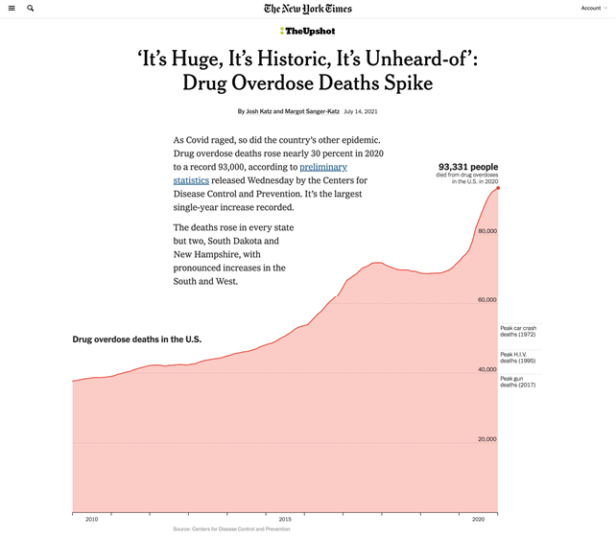
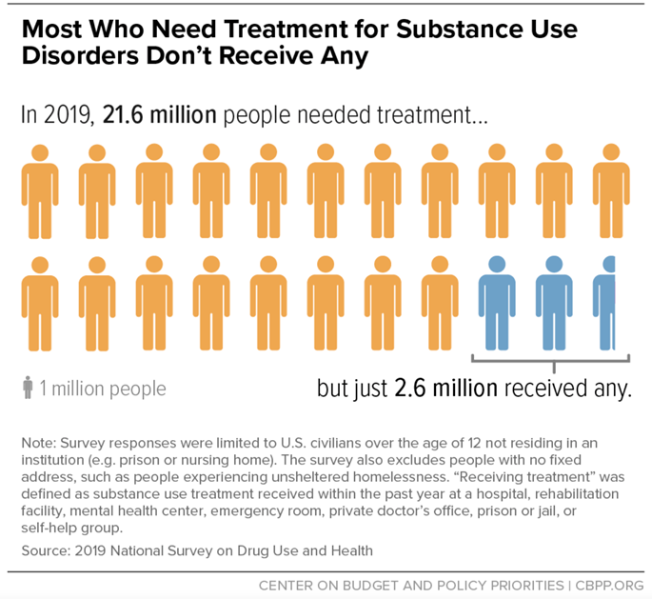
Background
Katz J, Sanger-Katz M. 'It's huge, it's historic, it's unheard-of': Drug overdose deaths spike. The New York Times. https://www.nytimes.com/interactive/2021/07/14/upshot/drug-overdose-deaths.html. Published July 14, 2021. Accessed February 1, 2022.
Most who need treatment for substance use disorders don't receive any. Center on Budget and Policy Priorities. https://www.cbpp.org/most-who-need-treatment-for-substance-use-disorders-dont-receive-any. Accessed February 1, 2022.

Slide 17
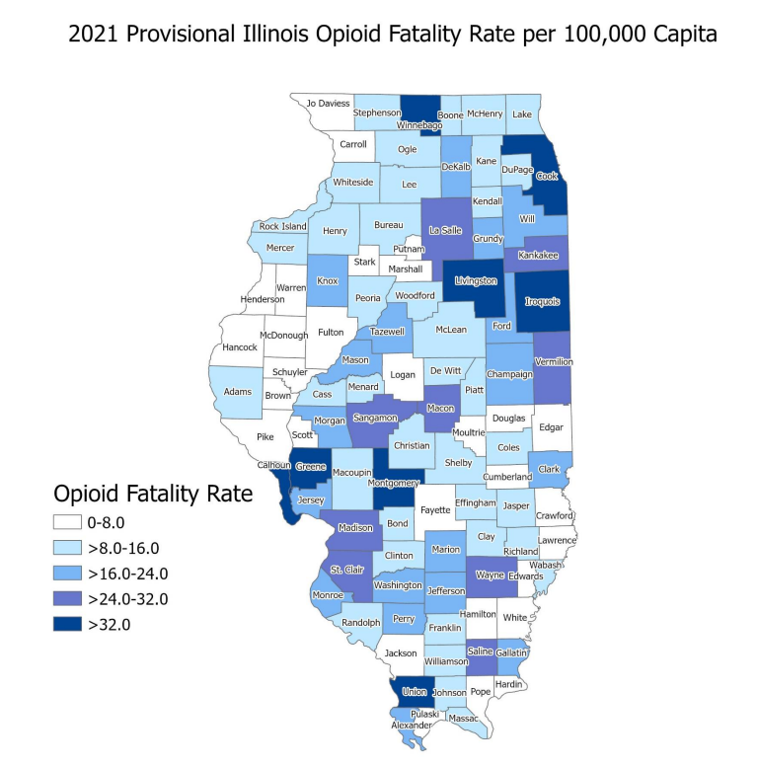
Background
Figure 3. 2021 provisional Illinois opioid fatality rate per 100,000 capita by county as reported by the Illinois
Vital Records System, IDPH. County-level fatality rates are calculated by the number of county residents who
died due to opioid overdose per year divided by the population of the county and multiplied by 100,000.
Counties with smaller populations could have rates higher than counties with larger populations, even though
there are fewer opioid fatalities.

Slide 18
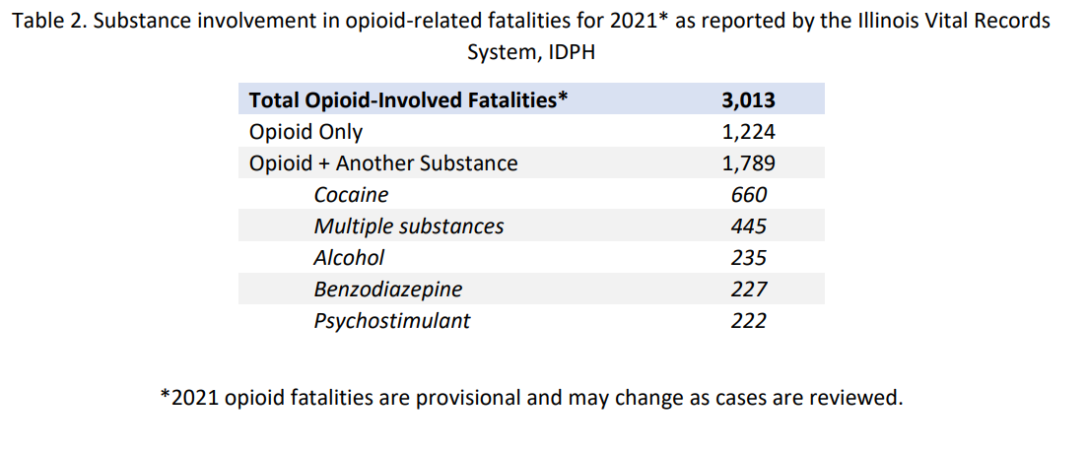
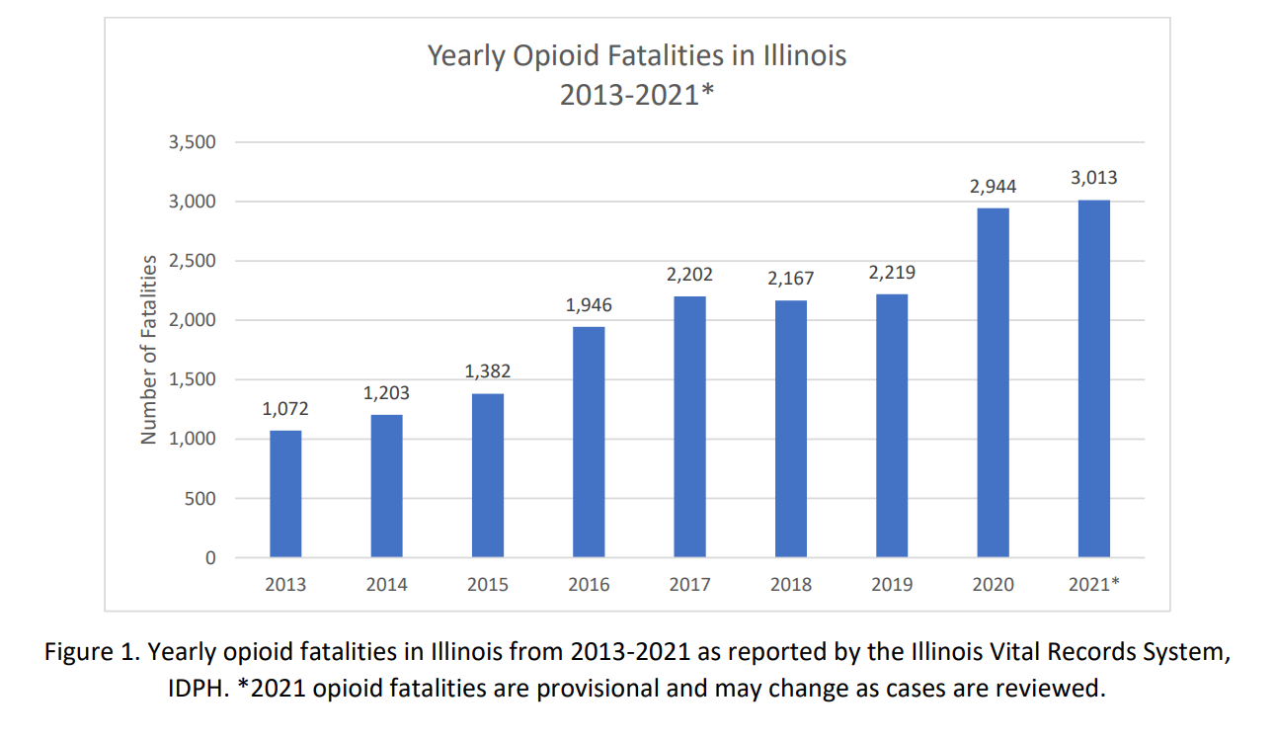
Background

Slide 19
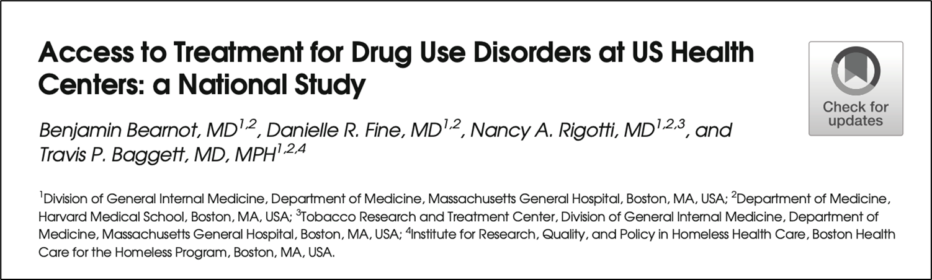
Stigma
In a national survey, among patients with substance use disorder who wanted but did not receive treatment, the most commonly reported reason for not obtaining treatment was stigma (69% of respondents).
Bearnot B, Fine DR, Rigotti NA, Baggett TP. Access to Treatment for Drug Use Disorders at US Health Centers: A National Study. J Gen Intern Med. 2019;34(12):2723-2725. doi:10.1007/s11606-019-05043-1

Slide 20
What is substance use disorder?
Many people use drugs and alcohol, but not all develop addiction
A substance use disorder is not just the use of drugs
Addiction is about the behaviors and symptoms around the use of drugs
Many people get better without formal treatment, but:
Treatment shortens the time until recovery
Treatment reduces negative outcomes along the way (HIV, mental illness, overdose, death)

Slide 21
Opioid Use Disorder Treatment
Behavioral health support - individual counseling, formal treatment programs
Medications for Opioid Use Disorder (MOUD)
Methadone
Buprenorphine (+/- naloxone)
Extended-release naltrexone
Note: “Detox” or supervised withdrawal is NOT effective treatment and INCREASES the risk of overdose if no linkage to next level of care (Strang et al., 2013)
Approximately one-third of substance use treatment providers offer methadone or buprenorphine (SAMHSA N-SSATS, 2019)

Slide 22
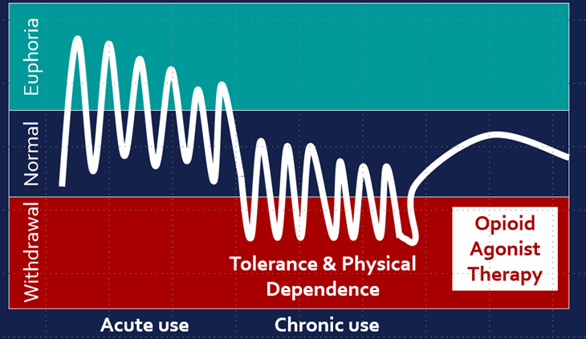
Opioid Use Disorder Treatment

Slide 23
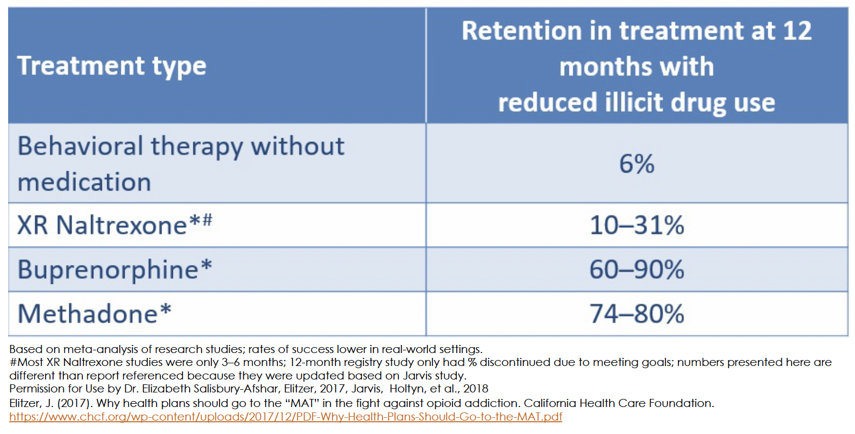
MAR is an Effective Treatment and Harm Reduction Intervention

Slide 24
Discussing medications that can treat OUD with patients who have this disorder is the clinical standard of care.
-SAMHSA Tip 63

Slide 25
MOUD and Mortality
Number Needed to Treat to Prevent 1 Death in 1 Year
Statins 415
Mammogram 2970
Buprenorphine after an overdose 33
Methadone after an overdose 31

Slide 26
Where to Initiate Treatment? EVERYWHERE!
Patients with OUD are frequently hospitalized with complications of OUD, but rarely is treatment for OUD initiated during these hospitalizations, many leave AMA due to untreated OUD
Patients present to the ER on average 6-9 times prior to an overdose death
Treatment initiation and retention significantly impacts morbidity and mortality
The hospital or ED may be their only access point to care
3-Day Rule (Methadone and Buprenorphine) Clarification
  Applies if their admission criteria is ONLY OUD
  Does NOT apply if they have a medical diagnosis for admission
    ie. Osteomyelitis require IV abx, start on methadone/titrate/stabilize, discharge to community methadone treatment program – do NOT prescribe methadone on discharge
    Ie. Cellulitis requiring IV abx, started and maintained on buprenorphine (non-x waivered provider), discharge to community treatment program – do NOT prescribe buprenorphine on discharge without an X-waiver
X-Waiver requirement for buprenorphine has been removed, any clinician with a DEA that can prescribe schedule 2, may prescribe buprenorphine
May now dispense 3-day supply from ED (one-time) under exception request to 21 CFR 1306.07(b) 3-day rule (EO-DEA248)
SAMHSA, TIP 63, 2020
https://www.deadiversion.usdoj.gov/drugreg/Instructions-to-request-exception-to-21CFR1306.07(b)-3-day-rule-(EO-DEA248)-Clean.pdf

Slide 27
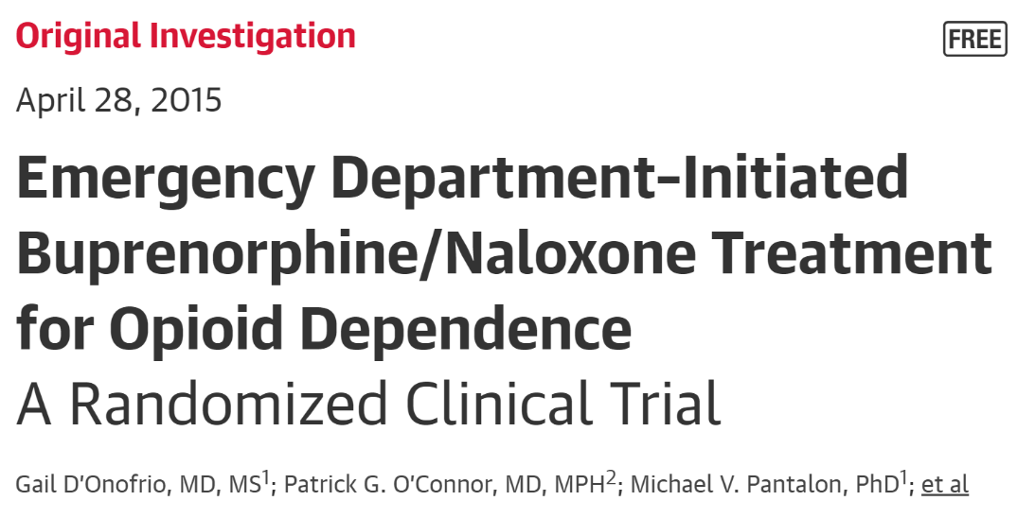
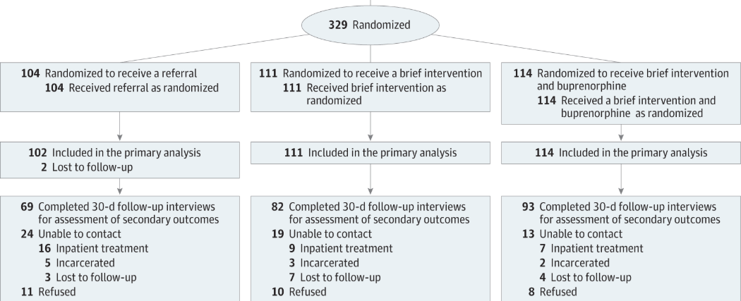
MAR is an Effective Treatment and Harm Reduction Intervention
30/102
50/111
89/114
receiving formal addiction treatment on the 30th day following randomization

Slide 28
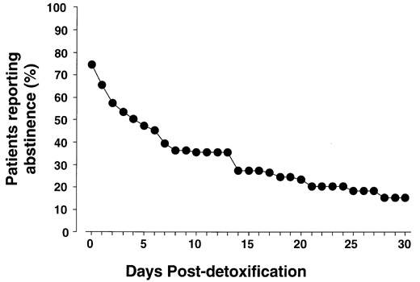
What about “Detox” or Medically Supervised Withdrawal?
“Medically supervised withdrawal” for OUD is a process in which providers offer methadone or buprenorphine on a short-term basis to reduce physical withdrawal signs and symptoms.”
Formerly called detoxification, this process decreases the dose until the medication is discontinued, typically over a period of days…”
“Studies show that most patients with OUD who undergo medically supervised withdrawal will start using opioids again and won’t continue in recommended care.”

Slide 29
Best Practices of the MSU or Inpatient: Evidence-based Medicine
“Opioid withdrawal management (i.e. detoxification) on its own, without ongoing treatment for opioid use disorder, is not a treatment method for opioid use disorder and is not recommended.”
Patients should be advised about the risk of relapse and other safety concerns, including increased risk of overdose and overdose death.
“Ongoing maintenance medication, in combination with psychosocial treatment appropriate for the patient’s needs, is the standard of care for treating opioid use disorder.”

Slide 30
Buprenorphine and Methadone
Adjunctive Medications Toolkit:
Anxiety, irritability, restlessness: Clonidine, Hydroxyzine, Benzos (rare)
Abdominal cramping, N/V/D: Dicyclomine, Ondansetron, Loperamide
Insomnia: Trazodone, Quetiapine
Muscle aches/spasms, HAs: NSAIDs, Acetaminophen, Cyclobenzaprine
Tobacco Use: Nicotine patch, gum

Slide 31
MAR NOW Program Overview

Slide 32
MAR NOW launched May 2022 as a Chicago Pilot, expanded Sept. 1 statewide
Funded by Chicago Department of Public Health (CDPH) and Illinois Department of Human Services Division of Substance Use Prevention and Recovery (IDHS/SUPR)
Operated by Family Guidance Centers, Inc. (FGC). FGC provides methadone, buprenorphine, and naltrexone at their Chicago and statewide clinics.
Operates through the existing 24/7 IL Helpline for Opioids and Other Substances: 833-234-6343, https://e.helplineil.org/mar-now/
Provides low-barrier, rapid access to buprenorphine, methadone, and naltrexone to all callers regardless of insurance status, income, ability to pay, or documentation status.

Slide 33
Program provides access to medication within 48 hours of first call
Patient Options:
Buprenorphine home induction
Same or next-day MAR appointment at FGC (methadone, buprenorphine, naltrexone)
Connection to other SUD care in the community (withdrawal management, residential treatment)
Individual calls 24/7 IL Helpline for OUD treatment, withdrawal support
IL Helpline directly transfers caller to MAR NOW Care Manager
24/7 Access
Connected to Care Manager & Provider
Care Managers provide free transportation, insurance enrollment, assistance with pharmacy access, and follow up to ensure patient is connected to long-term care

Slide 34
Hub and Spoke Model
MAR NOW works closely with pharmacies to ensure that they have medications available and are able to assist patients
Mental health providers
Pharmacies
Mental health, primary care, and harm reduction services are key referral points to and from MAR NOW
Harm reduction providers
MAR NOW
Primary care providers
All patients connected to outpatient MAR for long-term treatment in the community
Cook County Jail
Program is working closely with jail and homeless shelter providers to offer linkage to MAR NOW
Community MAR providers
Homeless shelters and encampment outreach
Patients that leave treatment can come back to MAR NOW and be connected again to treatment in the community. MAR NOW can also serve as a bridge clinic for patients waiting for care.

Slide 35
Where to initiate MAR treatment via MAR NOW? Everywhere!
In the Emergency Department
  Ask patient if they are interested in starting medication, re-started on medication or being connected to services for opioid use disorder
    If yes, have a team member give the patient access to a phone and they can call 833-234-6343
    The MAR team will take it from there including case management
Following Hospital Admission
  Ask patient if they are interested in starting medication, re-started on medication or being connected to services for opioid use disorder
    If yes, have a team member give the patient access to a phone and they can call 833-234-6343
    The MAR team will take it from there including case management
    Inpatient Team can start MAR if medically appropriate and MAR NOW case management team will coordinate follow-up and continuation
In the Urgent Care or Outpatient Setting
  Ask patient if they are interested in starting medication, re-started on medication or being connected to services for opioid use disorder
    If yes, have a team member give the patient access to a phone and they can call 833-234-6343
    The MAR team will take it from there including case management

Slide 36
Why initiate MAR treatment via MAR NOW?
Positively impact the opioid epidemic in your communities
Ease of use can decrease work burden for staff
Improve connection to services for patients without increasing clinical staff
The Joint Commission has a requirement under the chronic pain management standards that hospitals have a mechanism for referral for patients with OUD – utilizing the MAR NOW hotline easily meets that TJC quality standard

Slide 37


1-833-234-6343 (2FINDHELP)
Or text "HELP" to 833234

Slide 38
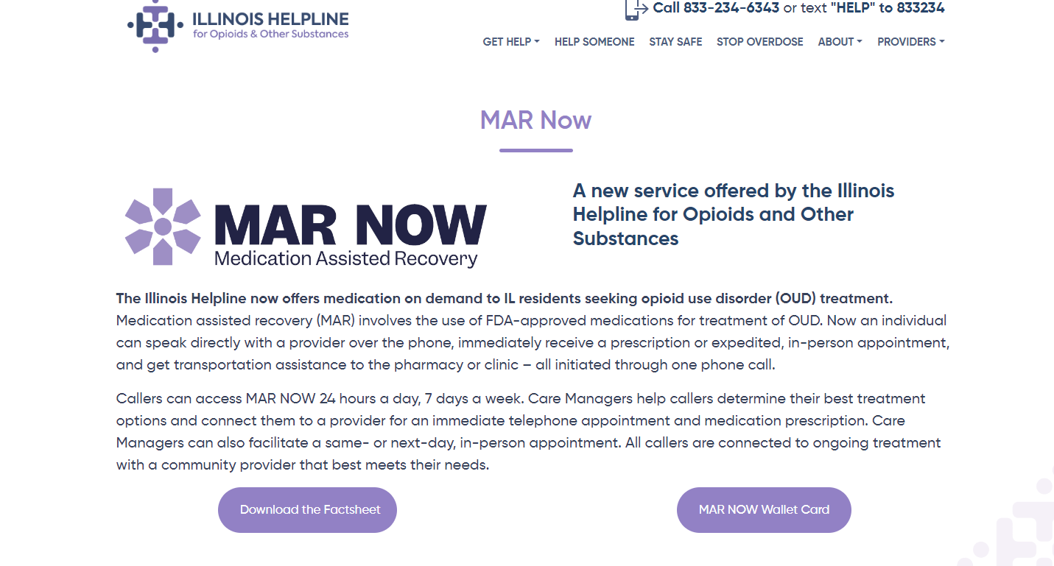

Slide 39
MAR restrictions have been waived under COVID to allow for low-barrier prescription
Buprenorphine may be prescribed via audio-only telemedicine
Initial in-person examination with provider before first buprenorphine prescription is waived
Buprenorphine providers may use non-HIPAA-compliant platforms to reach patients
In June 2022, the Office of National Drug Control Policy issued recommendations that the DEA and HHS make these changes permanent.

Slide 40
Initial Program Data & Learnings

Slide 41
Successful Connection to Care
May 9 – Feb 5, 2023: MAR NOW Call Data
 | Number | Percent of Total
Calls from patients seeking OUD care | 300
Patients seeking methadone | 106 | 35%
Patients seeking buprenorphine | 163 | 54%
Patients seeking withdrawal management w/ medical stabilization on MAR | 20 | 7%
Patients seeking residential treatment | 11 | 4%
May 9 – Feb 5, 2023: Patient Connection Data
 | Number | Percent of Total
Methadone patients attended first appointment | 74 | 70%
Buprenorphine patients connected to medication | 161 | 99%
Withdrawal management & medical stabilization patients who showed at appointment | 19 | 95%
Residential treatment patients who showed at appointment | 9 | 82%
*Note: connection to care pending for recent callers, data current as of Feb 5
Connection to care is high across all treatment options.
Patients connected to withdrawal management and medical stabilization are also connected to FGC's mobile van and MAR.

Slide 42
Home Induction Is Safe and Effective
May 9 – Feb 5, 2023: Buprenorphine Patient Data
 | Number | Percent of Total
Calls from patients seeking buprenorphine | 163
Buprenorphine patients connected to medication | 161 | 99%
Patients connected to medication that received home induction | 144 | 89%
Patients connected to medication that received in-person induction | 17 | 11%
Home induction patients connected to a community provider for ongoing care | 131 | 91%
Home induction patients that experienced adverse events during induction | 1 | 0.6%
Home induction patients terminated from care due to suspicions of misuse or diversion | 0 | 0%
*Note: connection to care pending for recent callers, data current as of Feb 5
FGC physicians provide a 7-day prescription for home induction, after which patients are connected to a community provider.

Slide 43
Home Induction Is Safe and Effective
May 9 – Feb 5, 2023: Buprenorphine Patient Data
 | Number | Percent of Total
Calls from patients seeking buprenorphine | 163
Buprenorphine patients connected to medication | 161 | 99%
Patients connected to medication that received home induction | 144 | 89%
Patients connected to medication that received in-person induction | 17 | 11%
Home induction patients connected to a community provider for ongoing care | 131 | 91%
Home induction patients that experienced adverse events during induction | 1 | 0.6%
Home induction patients terminated from care due to suspicions of misuse or diversion | 0 | 0%
*Note: connection to care pending for recent callers, data current as of Feb 5
FGC physicians provide a 7-day prescription for home induction, after which patients are connected to a community provider.

Slide 44
Case Study
A 63-year-old individual, confined to a wheelchair, was transferred to MAR NOW by the Illinois Helpline on a Sunday in mid-June at 11am. This caller was seeking methadone services and reported being a Medicaid (County Care) member.
The caller reported that they had previously received outpatient methadone services, but had a difficult time maintaining their participation in other programs. The FGC Care Manager helped the caller arrange to come to an FGC location near their home that same day. The caller arrived shortly after 12:30 pm. and was able to see FGC’s physician and receive their first dose of methadone by 2 pm. As of 2/14/23, they have not missed any doses and are actively participating in counseling services at FGC.

Slide 45
Case Study
A 40 year old female requesting buprenorphine for OUD treatment was connected to MAR NOW through the Illinois Helpline in mid-January at 1pm. She discussed treatment preferences with the Care Manager and the caller was immediately connected to an FGC Medical Provider for further consultation and assessment. Once the phone assessment was completed by the Medical Provider, the caller was prescribed buprenorphine (Suboxone) and was able to pick the medication up at the pharmacy requested later that afternoon which was confirmed by the Care Manager. The next morning the caller and Care Manager discussed ongoing treatment options near her and decided on Cook County Health for ongoing MAR care. The Care Manager was able to set up an appointment for the caller. Following the warm-hand-off to the spoke provider, the Care Manager completed a follow up phone call to confirm the individual was able to continue MAR, uninterrupted. During the 2 week follow up call, the caller informed the Care Manager that she remains engaged in buprenorphine treatment with Cook County Health.

Slide 46
Early Learnings
Providing transportation to clinic appointments and pharmacies lowers barriers to care and increases first appointment attendance rate
Concerted outreach to pharmacies is required to ensure that buprenorphine is available and pharmacists will fill prescriptions
Patients often need intensive follow-up from Care Managers to ensure they can make it to their first appointment.
Operating through the existing IL Helpline for Opioids and Other Substances provides baseline patient demand, aligns City and State efforts, streamlines expansion of program statewide, and allows for patient data matching to capture more information on demographics
Calls for withdrawal management and residential treatment are common, and provide opportunity for education around buprenorphine treatment.

Slide 47
Next Steps
Spoke Provider Development: FGC is working to build out spoke providers statewide.
  Contact Maria Bruni if interested in participating: mbruni@fgcinc.org
  Jennifer Cyran, Managing Director, Illinois Helpline, jcyran@hria.org
Provide Feedback: What’s working and what needs improved.
  Nicole Gastala, Medical Director SUPR/IDHS, Nicole.Gastala@illinois.gov
  Maria Bruni, mbruni@fgcinc.org
Evaluation: FGC is working with an external evaluator to understand:
  Patient behavioral, social/health needs and history
  Patient overdose and treatment history
  Retention in treatment at 3 months
  Patient experience and satisfaction with MAR NOW

Slide 48
Tele-buprenorphine Research
Aronowitz, Shoshana V et al. “Telehealth for opioid use disorder treatment in low-barrier clinic settings: an exploration of clinician and staff perspectives.”Harm reduction journal vol. 18,1 119. 25 Nov. 2021.
Clark, Seth A., et al. "Using telehealth to improve buprenorphine access during and after COVID-19: A rapid response initiative in Rhode Island. "Journal of Substance Abuse Treatment124 (2021): 108283.
Eibl, Joseph K., et al. "The effectiveness of telemedicine-delivered opioid agonist therapy in a supervised clinical setting. "Drug and AlcoholDependence176 (2017): 133-138.
Guille, Constance et al. “Treatment of Opioid Use Disorder in Pregnant Women via Telemedicine: A Nonrandomized Controlled Trial.”JAMA network open vol. 3,1 e1920177. 3 Jan. 2020.
Harris, Robert et al. “Utilizing telemedicine during COVID-19 pandemic for a low-threshold, street-based buprenorphine program. ”Drug and alcohol dependence vol. 230 (2022): 109187.
Nordeck, Courtney D et al. “Adapting a Low-threshold Buprenorphine Program for Vulnerable Populations During the COVID-19 Pandemic.” Journal of addiction medicine vol. 15,5 (2021): 364-369.
Samuels, Elizabeth A et al. “Innovation During COVID-19: Improving Addiction Treatment Access.” Journal of addiction medicine vol. 14,4 (2020): e8-e9.
Tofighi, Babak MD, MSc; McNeely, Jennifer MD, MSc; Walzer, Dalia BS; Fansiwala, Kush BA; Demner, Adam MD; Chaudhury, Chloe S. BS; Subudhi, Ipsita BS; Schatz, Daniel MD, MSc; Reed, Timothy MD; Krawczyk, Noa PhD A Telemedicine Buprenorphine Clinic to Serve New York City, Journal of Addiction Medicine: February 05, 2021.
Uscher-Pines, Lori et al. “Health center implementation of telemedicine for opioid use disorders: A qualitative assessment of adopters and nonadopters.”Journal of substance abuse treatment vol. 115 (2020): 108037.
Zheng, Wanhonget al. “Treatment Outcome Comparison Between Telepsychiatry and Face-to-face Buprenorphine Medication-assisted Treatment for Opioid Use Disorder: A 2-Year Retrospective Data Analysis.” Journal of addiction medicine vol. 11,2 (2017): 138-144.

Slide 49
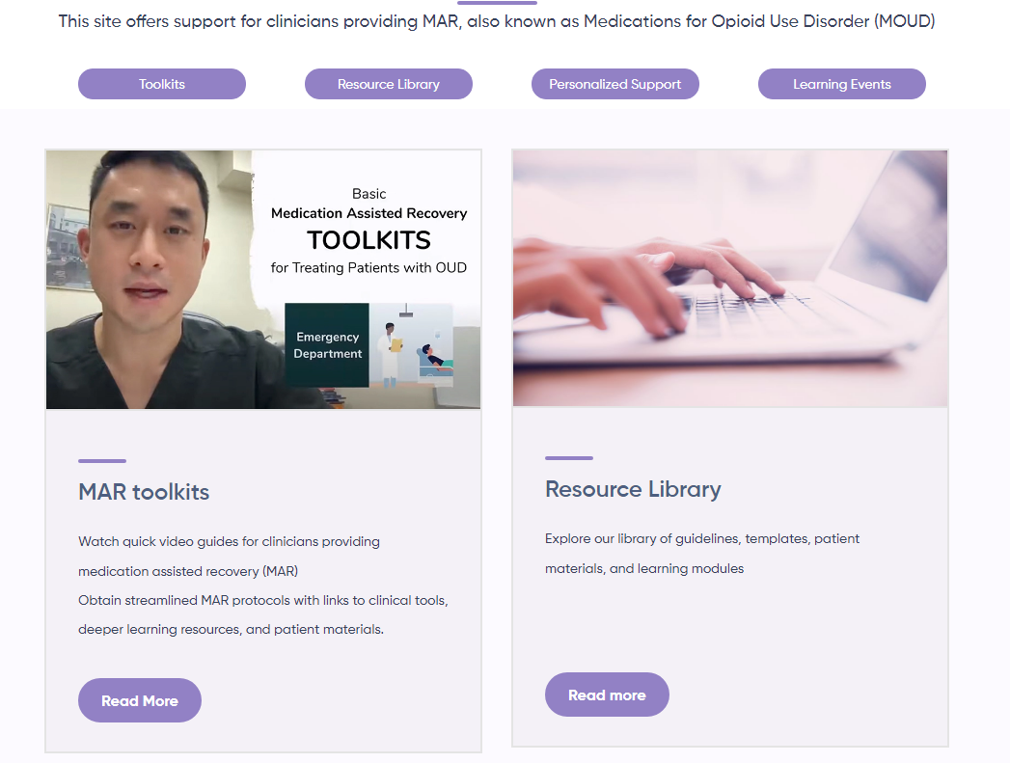

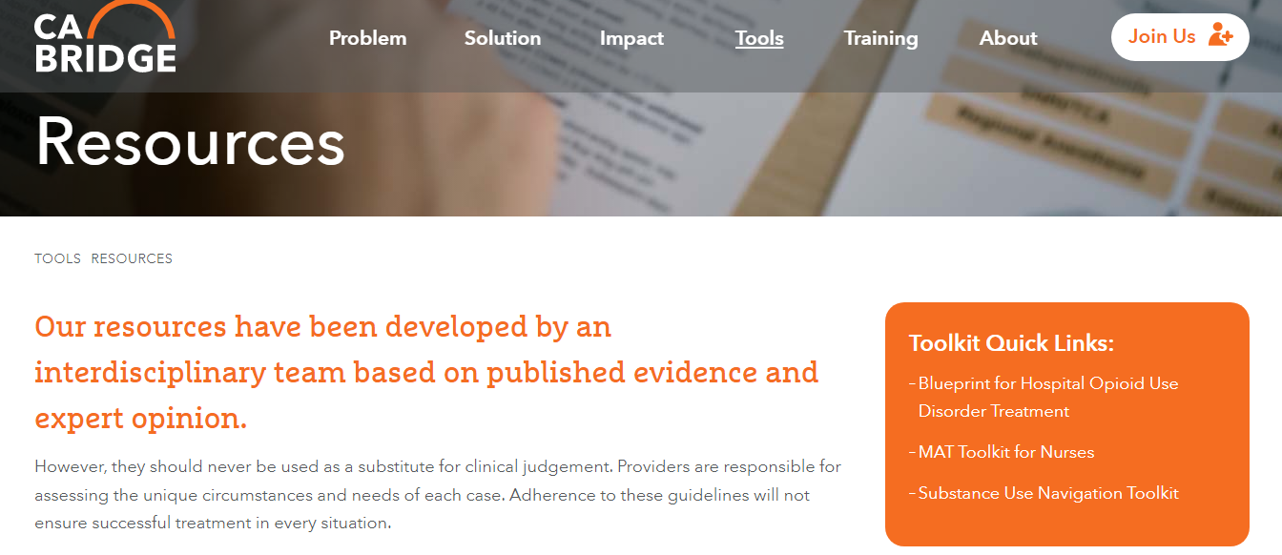
Tools and Resources
For Clinicians:
https://helplineil.org/app/mar
https://cabridge.org/tools/resources/
https://pcssnow.org/
For Patients:
https://helplineil.org/app/home
Patient Education Tools:
https://rethinkrecoveryil.com/

Slide 50
Recovery Landscape
Kim Sriner, LCPC, CRSS
Statewide Coordinator of Residential Recovery Services
Division of Substance Use Prevention & Recovery

Slide 51
Traditional Treatment System PLUS…
Recovery-Oriented System of Care (ROSC) Councils
Recovery Community Organizations (RCOs)
Recovery Support Services (RSS)
Recovery Residences

Slide 52
ROSC Councils
Coordinated network of community-based services and supports
Build a culture that nurtures recovery
Build capacity to support recovery
Develop commitment to sustain recovery
35 ROSC Councils covering 50 counties

Slide 53
Recovery Community Organizations
Intendent, non-profit organizations
Led and governed by people in recovery
Provide recovery support services in their community
8 RCOs (including 1 coalition made up of an additional 8 providers) covering 17 counties

Slide 54
Recovery Support Services
Employment coaching
Peer coaching
Recovery coaching
Recovery skills
Spiritual support
Transportation
Employment training
7 RSS providers covering 8 counties

Slide 55
Recovery Residences
Recovery Homes
  Special populations: women with children, DCFS-involved, HIV+, Co-occurring disorder, re-entry from IDOC/jail
  98 Recovery Homes, total of 1984 beds
Oxford Houses
  Populations: Women, Men, Women with children, Men with children
  72 Oxford Houses, total of 569 beds
Sober Living Facilities

Slide 56
Other Recovery Residences
Enhanced Recovery Homes for Pregnant & Postpartum Persons
Permanent Supportive Housing

Slide 57
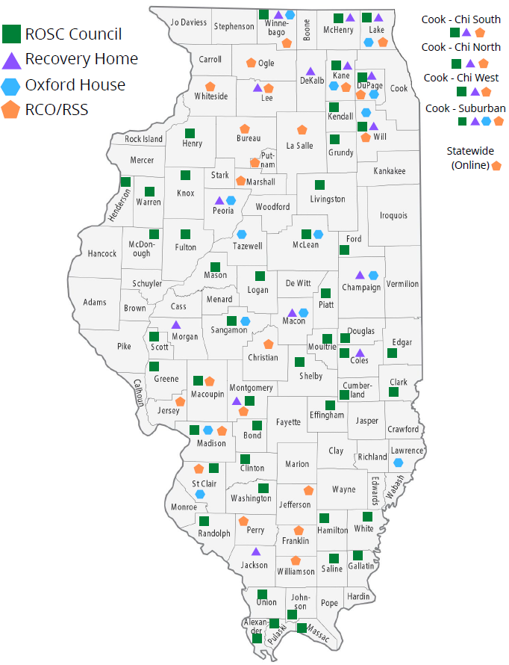

Slide 58

Helpline
SUPR
Recovery Homes
ROSC Councils
Permanent Supportive Housing
Gambling
Harm Reduction
CRSS Success Program
DMH
Faces and Voices of Recovery
Family and Youth Programming
RECOVERY PARTNERS
Centers for Community Engagement
Recovery Community Organizations
Oxford Houses
Pregnant and Postpartum Individuals
Justice Involved Populations
Sober Living Facilities
Recovery Support Service Providers
Recovery Corps
Recovery Cafés
Peers

Slide 59
What is Recovery?
“A process of change through which individuals improve their health and wellness, live a self-directed life, and strive to reach their full potential.” – SAMHSA
Guiding Principles
  Hope
  Person-Driven
  Many Pathways
  Holistic
  Peer Support
  Relational
  Culture
  Addresses Trauma
  Strengths/Responsibility
  Respect

Slide 60
What Does Recovery Look Like?
Eight Dimensions of Wellness
  Emotional
  Spiritual
  Intellectual
  Physical
  Environmental
  Financial
  Occupational
  Social

Slide 61
Innovations in Recovery
Harm Reduction vending machine
Sober bars
Crossfit/group workout
“From Harm to Hope” art exhibit
Cooking night
“Never Use Alone” program
WhatsApp groups to connect people with resources
“NatureRx” – guided walks, meditation
SUDS laundry events
Overdose awareness coasters at bars, restaurants

Slide 62
Innovations in Recovery
“Leave Behind Kits” for first responders, school buses
Facebook live and podcasts about recovery
Coat drives and food pantry distributions
Walk for Recovery and Recovery Jamboree
Narcan and overdose kits for tent cities
Recovery cafes and recovery coffeehouses
Financial literacy workshop
“Hidden in Plain Sight” trainings for guardians
Resource and sober social guides
Comedy night fundraiser

Slide 63
Innovations in Recovery
Mobile outreach van
Music lessons for young adults
Pop-up events at nursing homes, barber shops
Outreach to the jails for re-entry population
Greencorps Chicago
Dungeons & Dragons to build coping strategies
Community gardens
Therapy dogs
Forest clean-up
Sober outings and events

Slide 64
An Overview of Illinois Opioid Settlement Funds
Sherrine Peyton,
State Opioid Settlement Administrator
Office of Opioid Settlement Administration

Slide 65
$26 BILLION NATIONAL OPIOID SETTLEMENT AGREEMENT
2022 Illinois is eligible for $760M in National Opioid Settlement Agreement
The second largest multistate agreement in U.S. history, second only to the Tobacco Master Settlement Agreement.
Illinois is one of 52 states and territories that have joined the agreement, along with thousands of local governments across the country.
Illinois is eligible for the maximum amount of funds ($760M) available for the state (94 out of 102 counties and 104 out of 113 Illinois municipalities that are eligible to receive a direct distribution from the settlements have joined) have joined the settlements.

Slide 66
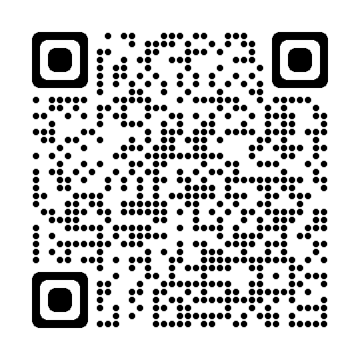
Established the Governor’s Opioid Prevention and Recovery Steering Committee
Guide the work of the Illinois Opioid Crisis Response Advisory Council (established in 2017)
Formulate an action plan for the State Opioid Action Plan
Establish local Recovery Oriented Systems of Care (ROSCs) councils
Create policies for Medically Assisted Treatment programs
Maintain and promote the HelpLine
Executive Order 2020-02
https://www2.illinois.gov/IISNews/21086-Executive_Order_2020-02.pdf
Notes:
) and its various subcommittees; all of which are comprised of
local and state partners from state agencies,
members of the General Assembly,
statewide provider organizations,
professional/trade organizations,
community-based providers in prevention, treatment, recovery and harm reduction,
county health departments,
county coroners,
hospitals,
local coalitions, and
people with lived experience.

Slide 67
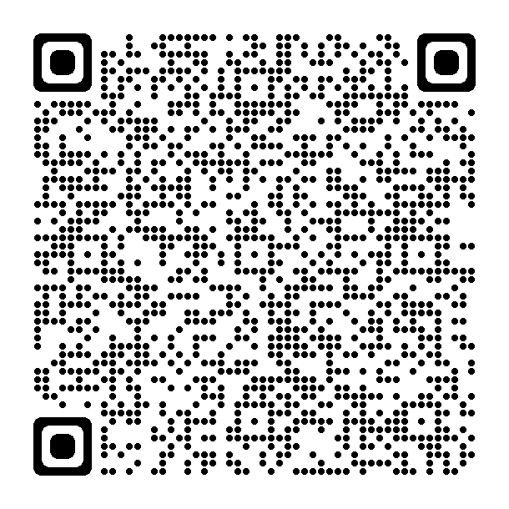
State Overdose Action Plan (SOAP)
SOAP March 2022
25 Priorities that fall under 5 Categories
Social Equity
Prevention
Treatment and Recovery
Harm Reduction
Justice-Involved Populations and Public Safety
https://www.dhs.state.il.us/OneNetLibrary/27896/documents/By_Division/SUPR/State-of-Illinois-Overdose-Action-Plan-March-2022.pdf

Slide 68
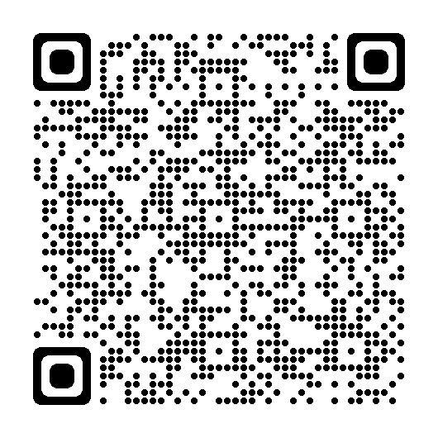
Executive Order 2022-19
Illinois Opioid Settlement Funds
Established the Illinois Opioid Remediation Advisory Board (Board)
The Office of Opioid Settlement Administration
A Statewide Opioid Settlement Administrator
Notified Illinoisians that 55% of the proceeds are allocated to the Illinois Opioid Remediation State Trust Fund
Funds must be used for forward-looking opioid abatement purposes
Executive Order 2022-19 (illinois.gov)
Notes:
Of the initial appointments, four (4) State appointments and four (4) local appointments shall each serve a term of two years; four (4) State appointments and four (4) local appointments shall each serve a term of four years.

Slide 69
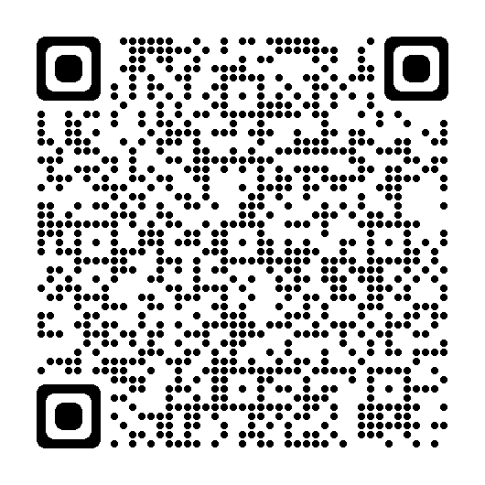
Illinois Settlement Agreement: 55% for Remediation
The majority will go to the Illinois Remediation Fund to be used for abatement programs (Core Strategies) throughout the state:
Naloxone or Other FDA-Approved Drug to Reverse Opioid Overdoses
Medication Assisted Treatment/Medication Assisted Recovery
Services for Pregnant and Post-Partum People with Opioid Use Disorder
Services for Neonatal-Abstinence Syndrome
Bridge Services (warm hand-off) and Recovery Oriented Services
Treatment of Incarcerated People
Prevention Programs
Harm Reduction & Syringe Service Programs
Illinois-Opioid-Allocation-Agreement-Fully-Executed.pdf (nationalopioidsettlement.com)

Slide 70
Executive Order 2022-19
Working Groups
(consider requests)
Advisory Board
(Make Recommendations)
Steering Committee
(approval)
Illinois Settlement Agreement: 55% for Remediation
Allocation Process

Slide 71
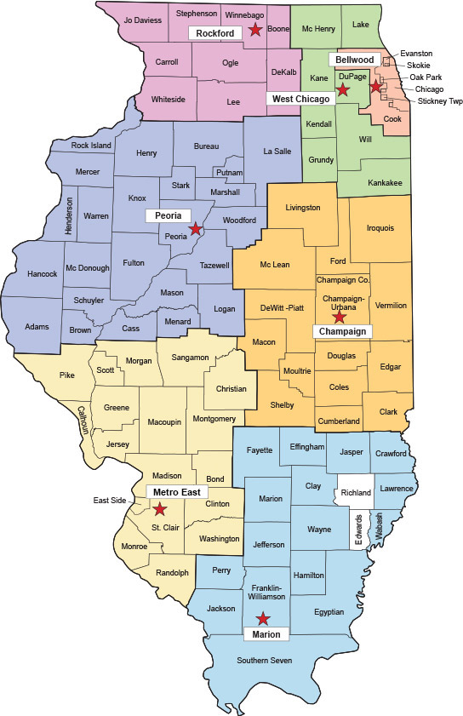
“Equitable Distribution”
# | Region | Average Opioid Use Disorder Rate* | Average Adjusted Overdose Death Rate** | MMEs%*** | Population %****
Region 1 | Bellwood | 0.63 | 10.66 | 29.38% | 40.64%
Region 2 | West Chicago | 0.63 | 10.34 | 26.03% | 27.15%
Region 3 | Champaign | 0.7 | 9 | 7.76% | 6.46%
Region 4 | Marion | 0.74 | 10.81 | 7.90% | 4.20%
Region 5 | Metro East | 0.7 | 10.62 | 11.70% | 8.29%
Region 6 | Peoria | 0.72 | 7.78 | 10.52% | 8.05%
Region 7 | Rockford | 0.63 | 9.51 | 6.71% | 5.22%
*Calculated by taking the sum of the opioid use disorder rates for all counties in a region and dividing that sum by the number of counties in the region. OUD rates use data from 2007-2016. **Calculated by taking the sum of adjusted overdose death rates for all counties in a region and dividing that sum by the number of counties in the region. Overdose rates use data for deaths between 2005-2016. The term "adjusted" refers to a methodology used to adjust figures to account for data issues, including overdose deaths where a drug was not identified. ***Represents amounts of opioids, as measured in morphine milligram equivalents (MMEs); Includes MMEs shipped between 2006-2014 ****Population reported in the 2019 Census estimates
Notes:
*Calculated by taking the sum of the opioid use disorder rates for all counties in a region and dividing that sum by the number of counties in the region. OUD rates use data from 2007-2016.
**Calculated by taking the sum of adjusted overdose death rates for all counties in a region and dividing that sum by the number of counties in the region. Overdose rates use data for deaths between 2005-2016. The term "adjusted" refers to a methodology used to adjust figures to account for data issues, including overdose deaths where a drug was not identified.
***Represents amounts of opioids, as measured in morphine milligram equivalents (MMEs); Includes MMEs shipped between 2006-2014
****Population reported in the 2019 Census estimates

Slide 72
Once approved by the Steering Committee:
Certified by the Attorney General’s Office
Equitable funded throughout the state
Subject to the procurement process

Slide 73
Approved Strategies to Date
Community Interventions (Treatment)
$3M
Community Outreach & Recovery Model
$5M
Access Narcan
$4.5M
Prescription Monitoring Program
$3.75M

Slide 74
Illinois Opioid Remediation Advisory Board (IORAB)
IDHS: Illinois Opioid Remediation Advisory Board (state.il.us)
Thank you,
Sherrine Peyton
Statewide Opioid Settlement Administrator
IDHS/SUPR
sherrine.peyton@illinois.gov
217-720-7250

Slide 75

State of the State:
Becoming “Gambling Informed”
Kellie Gage, M.S., CAADC
Gambling Program Manager
IDHS/SUPR

Slide 76

This Photo by Unknown Author is licensed under CC BY
Defining Gambling?
Risking something of value such as money on an unpredictable event.
The Gamblers Anonymous-Combo Book defines gambling for the compulsive gambler as any betting or wagering, for self or others, whether for money or not, no matter how slight or insignificant, where the outcome is uncertain or depends upon chance or “skill.”

Slide 77
What is Gambling?
Types Gambling
Bingo
Raffles
Dice
Sweepstakes
Stock Market/Commodity
Fantasy Sports
Games of Skill
Video Gaming
Scratch offs

Slide 78
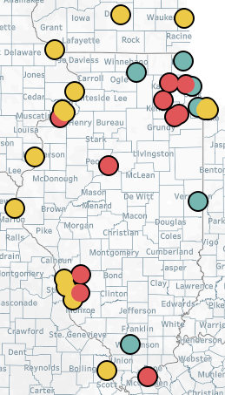

Gambling Availability in Illinois
Illinois Landscape
Casinos
  10 Casinos (red) in IL
  6 additional sites this year (grey)
  14 out-of-state casinos along IL borders
Sports Betting
  In October 2022 – IL surpassed $1 billion in a single month
  Sports betting is the fastest growing referral group for providers and the Illinois Gambling Board Self-Exclusion Program
Video Game Terminals
  44,950
  Prior to sports betting, Lottery was the most common gambling issue with $3.455 billion in sales
DATA SOURCE: IL Problem Gambling Assessment, Frequent Gambler Sample, 2021

Slide 79
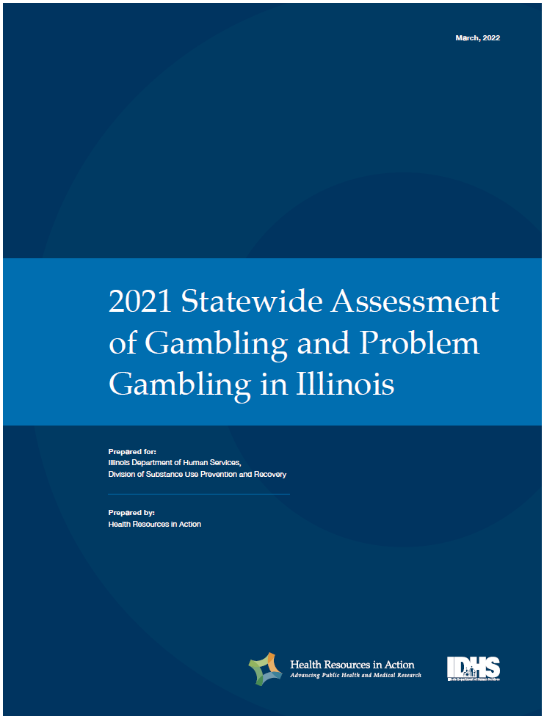
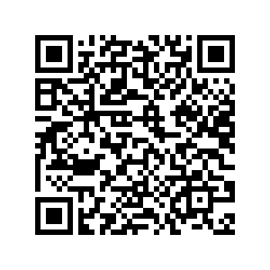
Illinois Problem Gambling Needs Assessment
The statewide gambling needs assessment conducted by Health Resources in Action (HRiA) began in SFY20.
The final report was released on June 16, 2022.
To access the study, scan the QR code below:

Slide 80
Main Study Goal
Determine the prevalence of gambling-related behaviors and problem gambling in Illinois, including for vulnerable populations or those marginalized due to race, culture, or socioeconomic disparities.
Inform a strategic initiative for preventing and addressing problem gambling in the state.
We Found
A higher prevalence of problem gambling among Indigenous, Black, Hispanic/Latinx and Asian communities
  Racial discrimination, acculturative stressors, targeted marketing
Older adults and young people
  Low income, socialization, social isolation, targeted marketing

Slide 81

Illinois Problem Gambling Needs Assessment
Gambling Disorder Prevalence in Illinois
9% of Illinoisan residents have or are at risk of having problem gambling
69% of people with problem gambling experienced comorbid mental health issues
30% of individuals with gambling disorder considered or attempted suicide.
11,668,508
Illinoisans
761,000
Illinoisans at risk
383,000
with gambling disorder
DATA SOURCE: IL Problem Gambling Assessment, Frequent Gambler Sample, 2021; 2020 Census
Notes:
Needs Assessment URL: https://e.helplineil.org/areyoureallywinning/statewide-gambling-assessment/

Slide 82
Illinois’ Response

Slide 83
SUPR Gambling Services
Provider Services
Technical Assistance
Needs Assessment
Public Awareness Campaign
Stigma
Resource Attainment
24/7 Helpline and Website
1-800-GAMBLER
AreYouReallyWinning.org
Provider Training/Education
Outreach/Screening
Treatment
Recovery Support
Outreach

Slide 84

IDHS/SUPR’s Gambling Treatment Providers
Alpha Omega
Associates in Behavioral Health Center
Centerstone of Illinois Inc.
Central East Alcoholism & Drug Council
Chestnut Health System
Ecker Center for Mental Health
Egyptian Public and Mental Health
Family Guidance Centers
Gateway Foundation
Remedies Renewing Lives
The South Suburban Council
TASC
Way Back Inn, Inc.
Heritage Behavioral Health​
HRDI, Inc.
Iroquois Mental Health Center
Jasper County Health Dept.
Leyden Family Services-The SHARE Program
McDermott Center
Midwest Asian Health Association
Nicasa

Slide 85
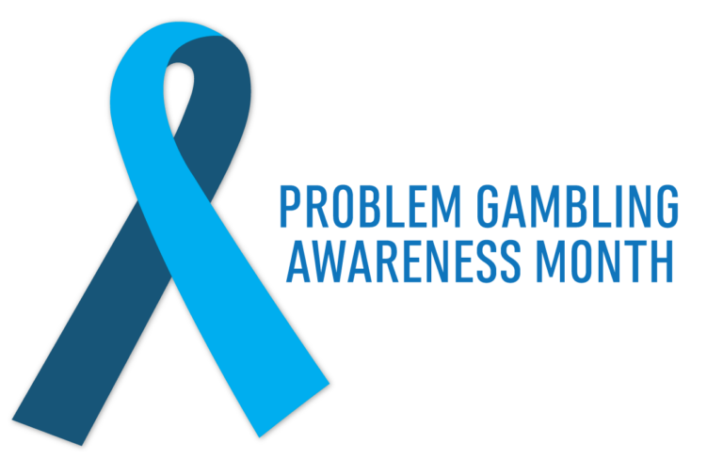
IDHS/SUPR’s Gambling
Outreach Providers
Association House of Chicago
Cutivadores-Cultivator
Cicero Family Services
IABH-Illinois Alcoholism & Drug
Illinois Council on Problem Gambling
Kenneth Young Center
LaKar Enterprises
Pui Tak Center

Slide 86
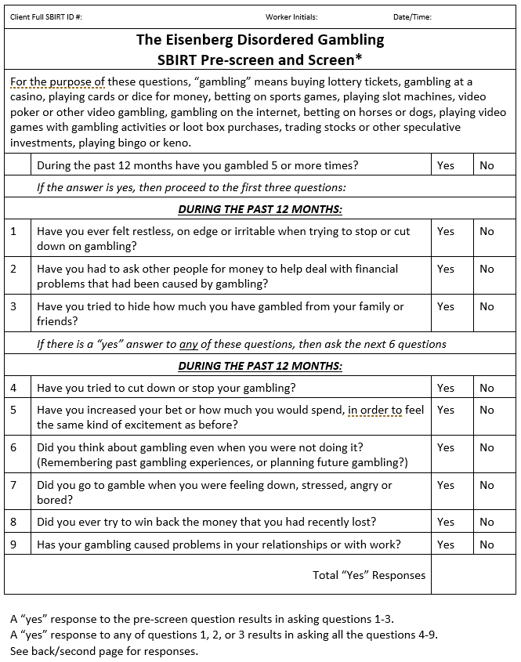
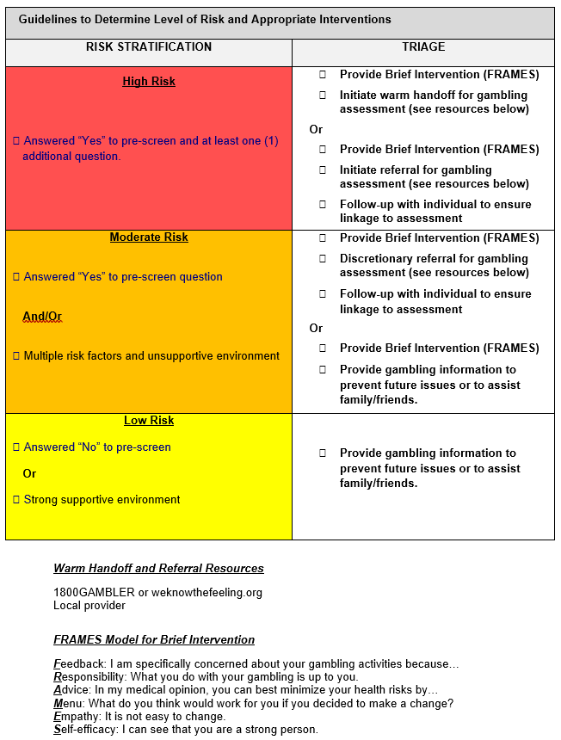

Slide 87
Helpline and Website
1.800.GAMBLER and AreYouReallyWinning.com
429% increase in traffic to the website in SFY22 compared to prior years.
  SFY23 YTD website traffic is double SFY22
4,461 calls to the Gambling Helpline SFY23 YTD
  524 referrals made to gambling treatment SFY23 YTD
Website Visits

Slide 88

New Public Awareness Campaign
Are You Really Winning?
Campaign includes
  Social media ads including geofencing
  PR events with news organizations and sports teams
  Billboards
  Radio and TV ads
SFY23 YTD 342 outreach events have been held resulting in 15,429 screenings
Campaign materials developed so providers can attach logos/contact information

Slide 89

DHS/SUPR Sponsored Problem Gambling Training
1100 people have registered for 27 trainings in SFY23
First Latinx gambling disorder conference held in Cicero, IL
First physician focused gambling conference in March at Rush University
Rush University is adding the gambling core training to their curriculum for doctors.
SUPR, in collaboration with the Illinois Gaming Board
created the voluntary self-exclusion guidelines
for clinicians.

Slide 90
MARCH IS PROBLEM GAMBLING AWARENESS MONTH
March marks the 20th annual Problem Gambling Awareness Month (PGAM), a campaign from the National Council on Problem Gambling, the gaming industry, state health agencies, and a wide range of recovery groups and healthcare organizations to increase awareness of problem gambling and the availability of prevention, treatment, and recovery services across the country.
Americans are expected to wager over $3 billion during March Madness

Slide 91


Problem Gambling Awareness Month (PGAM)
Activities for March 2023 (PGAM)
National Gambling Screening Day - 9 casinos have agreed to host providers for on-site screenings
Chicago skyline illuminated March 20-26, 2023
Governor’s Proclamation honoring PGAM
Multiple provider outreach and screening events
Gambling Disorder training events
Additional public awareness campaign engagements

Slide 92
Thank You!
How to Get Involved
Participate in our FREE Trainings & Webinars
Screen (Using the GBIRT)
Refer to Gambling Treatment Providers
Promote the 1-800-GAMBLER Help Line
Watch for opportunities to become a funded provider
  Notice of Funding Opportunity (NOFO)
Spread the Word to help Illinois become a
Gambling Informed State

Slide 93
Call To Action
If you or someone you know is experiencing problems with gambling, confidential assistance is available 24/7 at the State's Gambling Helpline:
1-800-GAMBLER
AreYouReallyWinning.com
Text "ILGamb" to 833234

Slide 94
The 988 Suicide and Crisis Lifeline
Lee Ann Reinert, LCSW
Deputy Director of Policy, Planning and Innovation
Division of Mental Health

Slide 95
IDHS/ DMH’s mission
Vision: All people in Illinois achieve their full potential.
Mission: To ensure equitable access to a full continuum of preventive, supportive, and recovery-focused treatment resources that promote mental wellness for all people.

Slide 96
Expansion of the Crisis Continuum
SAMHSA’s Model for Crisis Care “Meeting Needs, Saving Lives”
DMH Grants for Crisis Programs
988 Suicide and Crisis Lifeline National and State Planning
Community Emergency Services and Support Act (CESSA)

Slide 97
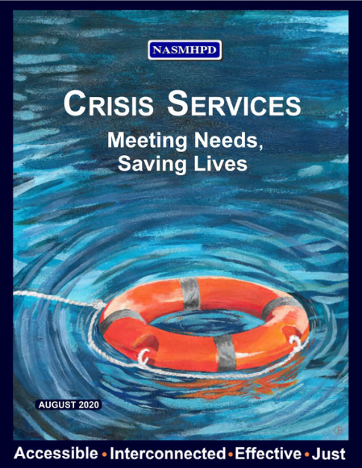
Expanding Illinois' Continuum of Crisis Services
Someone to Call (988 Regional Crisis Call Hub Services)
  6 call centers with Lifeline Contracts through Vibrant Emotional Health
Someone to Respond (Mobile Crisis Team Services)
  Program 590 built upon existing crisis staffing to expand service capacity and establish mobile crisis response team capability
Somewhere to Go (Crisis Receiving & Stabilization Units)
  20 Living Rooms with planned expansion for FY24
  11 Crisis Residential Programs
  Crisis Stabilization Units with different models and funding streams

Slide 98

988 Suicide & Crisis Lifeline
Crisis Care for Everyone, Everywhere, Every Time
988
988 is built upon the traditional National Suicide Prevention 800 number framework and:
  Is available 24/7/365
  Provides universal and convenient access to everyone in the United States/territories
  The goal is a high quality and personalized experience
  Has planned enhancements to standardize how services are provided across the Lifeline network
  Is making new investments to ensure efficient routing, timely response, tailored support, and accurate reporting.
  Includes connections to local resources and follow-up

Slide 99
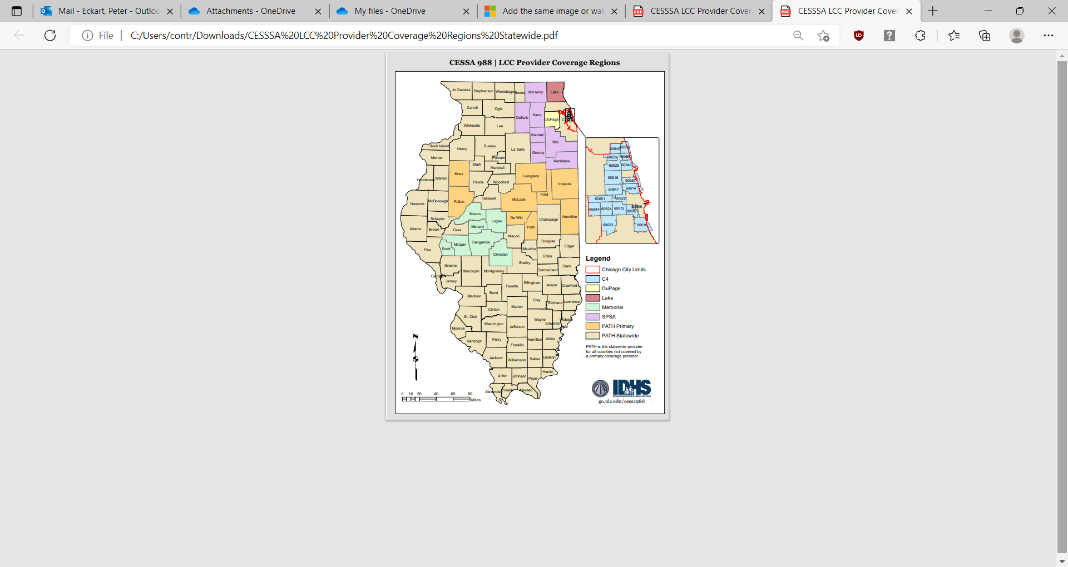
988 in Illinois
Lifeline Affiliated Call Centers:
PATH (Bloomington) – 85 counties-primary; statewide - backup
Memorial Behavioral Health (Springfield) – 7 counties
Suicide Prevention Services (Batavia) – 7 counties
DuPage County Health Department (Wheaton)
Lake County Health Department / Crisis Care Program (Waukegan)
Community Counseling Centers of Chicago [C4] – 19 zip codes

Slide 100
Program 590 – Crisis Care Continuum
SAMHSA’s model includes crisis clinicians and engagement specialists
CESSA’s goal is reduced reliance on law enforcement
Interim guidance developed for use by 590 and 988 teams
590 Programs participate in evaluation by UIC
UIC Crisis Hub provides training and technical assistance
Learning Collaborative including statewide and regional groupings

Slide 101
CESSA
Also known as the Stephon Edward Watts Act
DHS is mandated to lead this work
Requires Statewide Advisory Committee and Regional Committees within each of the 11 EMS Regions
Committees are charged with coordination of emergency responses of the 911 and PSAPs with plans for 988 addressing
  Protocols
  Training
  Standards
  Mobile Crisis Response

Slide 102

Coordinating with Traditional First Responders
CESSA
Public Safety Access Points (PSAPs) must coordinate with Mobile Crisis Response (MCR) teams DMH has developed through its Program 590 to provide a “community-based” response to low-level and low-risk behavioral health crises.
Law enforcement must be integrated into processes so that individuals involved in low-level non-violent misdemeanors can be diverted to the mental health system.

Slide 103

CESSA
Coordination and Training Requirements
180 911/ PSAPs and dispatched emergency service providers
66 Mobile Crisis Team program grantees
so mobile crisis response can be dispatched whether 988 or 911 is called.
Specified training will be required for all DMH responders and 911 dispatchers.

Slide 104
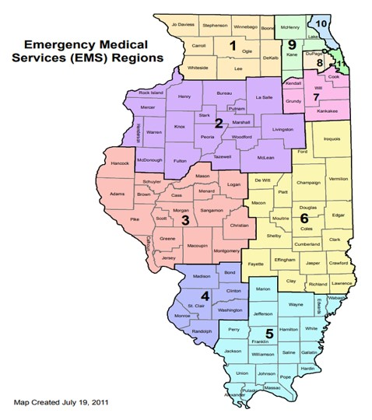
CESSA
Advisory Committees established by the DHS Secretary
1 Statewide Advisory Committee
11 Regional Advisory Committees to assist with the execution of this legislation.
Regional best practices will be developed by the Regional Advisory Committees consistent with the physical realities of various locations.

Slide 105
Additional Resources
IDHS 988 landing page: www.988hotline.illinois.gov
IDHS: 988 Suicide & Crisis Lifeline Planning Page (state.il.us)
Substance Abuse and Mental Health Services Administration https://www.samhsa.gov/find-help/988
SAMHSA Store 988 Partner Toolkit | SAMHSA
DHS.DMH.CESSA@illinois.gov

Slide 106
Integrated Care
Amanda Lake, SUD Senior Policy Advisor, SUPR

Slide 107
What is “Integrated Care”?
In healthcare broadly, integrated care refers to the concurrent and collaborative treatment of behavioral health and general medical care services, occurring in the same setting or through closely coordinated provision of care. Examples include provision of MOUD in primary care settings, Federally-Qualified Healthcare Centers that provide behavioral health services alongside medical and dental care, and mental health or substance use treatment settings that provide medical services directly or through collaborative partnerships.
In behavioral health, integrated care refers to the assessment and treatment of mental health and substance use disorders that is provided in the same setting, typically under a single treatment plan. Integrated care is a “no wrong door” approach where individuals with MH, SUD, or co-occurring disorders receive concurrent treatment through collaborative approaches delivered by professionals with training and competence in the treatment of both mental health and substance use disorders.

Slide 108
Integrated Care: Themes and Challenges
"No wrong-door"
Coordination of care
Concurrent treatment
Recovery supports
Person-centered and individualized care
Evidence-based practice
Workforce; professional training
Statutory authority and administrative rules
Policies and procedures
Funding and reimbursement
Scope- generalist vs. specialist
Lack of system alignment
Theoretical orientations and interventions
Stigma
Siloed service systems

Slide 109
Crisis System of Care
&
Certified Community Behavioral Health Clinics (CCBHC’s)

Slide 110
Crisis Services
Crisis Services: The Need for Integration
Over 106,000 Americans died as a result of a drug overdose in 2021.[i]
Of individuals that die by suicide, over 50% of completed toxicology screens show the presence of drugs or alcohol at the time of death[ii]. Substance use dramatically increases the risk of suicide and is a critical risk factor to be addressed in safety planning.
Substance use is implicated in up to 86% of homicides.[iii]
According to SAMHSA, individuals using substances are 10-15 times more likely to die by suicide than individuals who do not use substances[iv].
[i] https://www.cdc.gov/nchs/products/databriefs/db457.htm
[ii] https://www.cdc.gov/mmwr/volumes/71/ss/ss7106a1.htm?s_cid=ss7106a1_w
[iii] https://www.rit.edu/liberalarts/sites/rit.edu.liberalarts/files/documents/our-work/2002-01.pdf
[iv] https://store.samhsa.gov/sites/default/files/d7/priv/sma16-4935.pdf

Slide 111
Crisis Services
National Association of State Mental Health Program Directors, August 2020
Addressing Substance Use in Behavioral Health Crisis Care: A Companion Resource to the SAMHSA Crisis Toolkit
"Historically, the entire continuum of care for behavioral health from prevention to recovery, including crisis intervention, has segregated care for mental and substance use disorders.
The SAMHSA Crisis toolkit, interview with Nick M., provides an account of a frustrating effort to access help for an individual in crisis who was turned away from psychiatric care because they were actively using substances, only to be subsequently turned away from substance use disorder care because they were suicidal.
"It is essential that the “Anyone” from “Anyone, Anywhere, Anytime” cited in SAMHSA Crisis Toolkit include substance use disorders meaningfully. Substance use disorders cannot be an afterthought in our approach to crisis care. Full integration of mental health and substance use disorders in treatment needs to be embraced across the continuum, which includes the crisis system."

Slide 112
Crisis Services
Developing capacity for integrated care throughout continuum:
Someone to call
9-8-8 and other crisis call lines are trained in screening and response for individuals with SUD and co-occurring disorders. Call lines are able to facilitate linkages to appropriate SUD services when indicated.
Someone to respond
Crisis responders are trained in SUD screening and intervention. Peer specialists include individuals with lived experience with SUD. Crisis response includes overdose response and naloxone distribution.
Somewhere to go
Crisis stabilization facilities are equipped to serve individuals with SUD, and the continuum of care includes both hospital and community-based withdrawal management services.
Addressing SUD Crisis Needs:
1. Overdose prevention and risk mitigation
2. Universal screening for SUD
3. Facilitating linkages to SUD treatment
4. Addressing individual, family, and community safety needs related to SUD
5. Providing community-based treatment settings for acute intoxication and/or withdrawal management and stabilization
6. Identifying and addressing substance-induced psychosis

Slide 113
Crisis Services
Building Integrated Care Services
Interdivisional partnerships with SUPR, Division of Mental Health, and Healthcare and Family Services
Interdepartmental collaborations with Illinois Department of Public Health, Department and Children and Family Services, Department of Corrections, Department of Insurance, and others
Inter-state learning collaborative; researching effective models from other states
Providing training regarding SUD's for crisis responders
Alignment of policies and standards across settings and programs
Emphasis and value on integration from state leadership

Slide 114
What is a CCBHC?
Initially developed within federal legislation, CCBHC’s have been implemented through state Medicaid demonstrations, as well as through federal grants.
The CCBHC program requires a prescribed service model, including integrated care and low-barrier rapid access, as well as an outlined scope of services that includes outpatient substance use and mental health services, and the availability of crisis services.
The goals of CCBHC’s are to improve access to behavioral health care, improve integrated care, and to provide a comprehensive reimbursement rate that covers more services, including care coordination.

Slide 115
Source: National Council for Mental Well-Being

Slide 116

Care Coordination:
The “Linchpin” of CCBHC
•CCBHC coordinates care across the spectrum of health services, including physical and behavioral health and other social services
•CCBHC establishes or maintains electronic health records (EHR)
- Health IT system is used to conduct population health management, quality improvement, reducing disparities, and for research and outreach

Slide 117
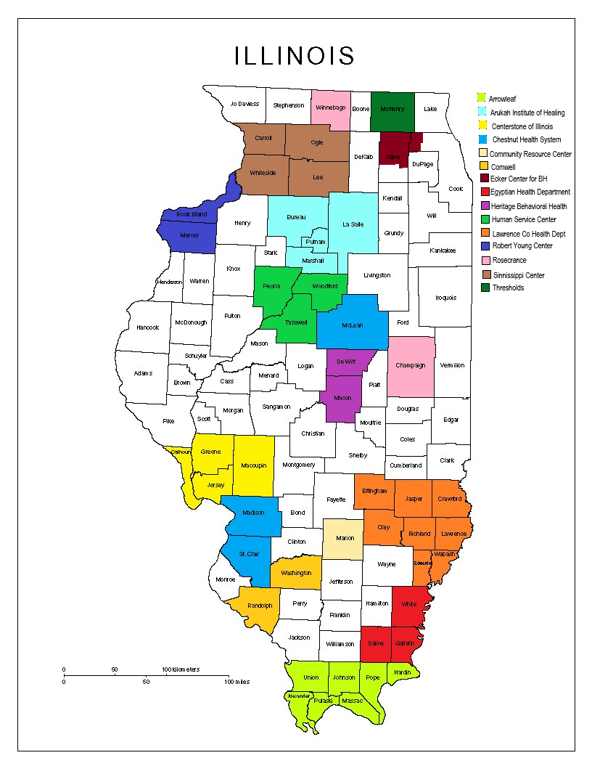
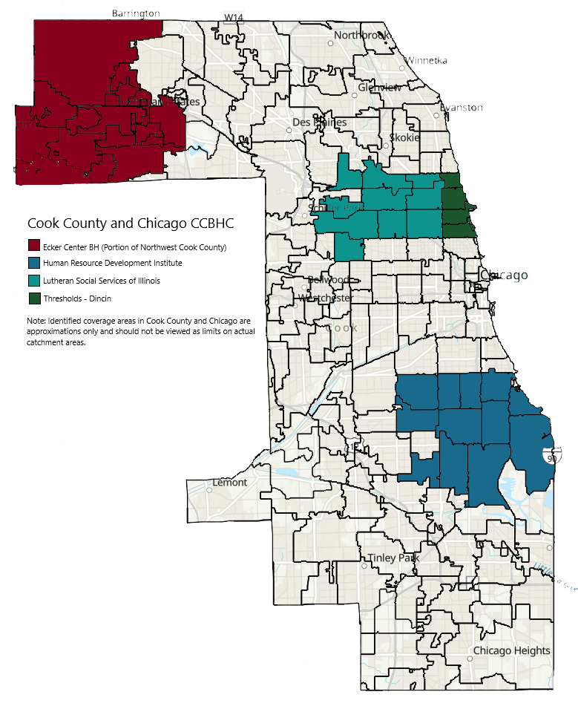
CCBHC's
Current CCBHC's in Illinois:
24 Providers/ recipients of federal CCBHC grants

Slide 118
Implementing CCBHC's in Illinois/ IDHS Next Steps:
Collaboration across state agencies and divisions for program and policy development
Providing training and technical assistance related to service requirements and integrated care best-practices
Ensuring alignment across service systems for seamless access to care
Developing a Medicaid rate structure to support CCBHC programs
Implications for BH services:
Increasing collaboration and partnerships across service providers
Increased emphasis on care coordination
Potential to change “front door” of service system
Model for support of complex and comorbid conditions

Slide 119
Workforce Initiatives
Amanda Lake, SUD Senior Policy Advisor, SUPR

Slide 120
Substance Use Workforce Shortage
According to HRSA, there is a projected nationwide shortage of up to 34,940 addiction counselors by 2030. Addiction counselors are second only to psychiatrists, in terms of behavioral health workforce shortages.
For Illinois, the HRSA National Center for Health Workforce Analysis projects a shortage of up to 1,030 addictions counselors by 2030.

Slide 121
Estimated Supply of and Demand for Addiction Counselors in the United States, 2016-2030
Scenario One (Assumes equilibrium) Scenario Two (Assumes unmet need)
Supply
Estimated supply, 2016 87,690 87,690
Estimated supply growth, 2016-2030: 5,220 (6%) 5,220 (6%)
New entrants, 2016 - 2030 38,780 38,780
Attrition, 2016 – 2030 a -34,890 -34,890
Changing work patterns b 1,330 1,330
Projected supply, 2030 92,910 92,910
Demand
Estimated demand, 2016 87,690 105,260
Estimated demand growth, 2016-2030 c 18,820 (21%) 22,590 (21%)
Projected demand, 2030 106,510 127,850
Projected Supply (minus) Demand, 2030 d -13,600 -34,940
Source: HRSA, https://bhw.hrsa.gov/sites/default/files/bureau-health-workforce/data-research/addiction-counselors-2018.pdf
Notes:
Note: All numbers reflect full-time equivalents (FTEs). Numbers may not sum to totals due to rounding.
a Includes retirements and mortality.
b For example, changes from full-time to part-time hours, or vice versa.
c Demand growth reflects changing demographics.
d The demand for addiction counselors may lag behind supply due to projection models’ use of current utilization patterns as the basis for future projections. This pattern of utilization may be due to lack of access to behavioral health care.

Slide 122
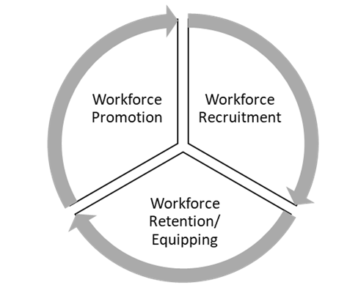
Behavioral Health Workforce- DMH/SUPR Collaborative Initiatives
Promotion
Behavioral Health Workforce Center
Promotion through CRSS Success and other program initiatives
Recruitment
CRSS/CPRS Success
*additional programs in development
Retention
Behavioral Health Professional Loan Repayment Program
Behavioral Health Workforce Center

Slide 123
Workforce Initiatives
Community Behavioral Health Professional Loan Repayment Program
The Community Behavioral Health Care Professional Loan Repayment Program provides loan repayment assistance to qualified mental health and substance use professionals. The program was designed as incentive for recruitment and retention of those who practice in underserved or rural areas. It seeks to help address the shortage of Illinois community-based behavioral workers that causes disparities in access to critical mental health and substance use services. The amount of the annual award to qualified applicants to repay their student loan debt is based on their position and may be received for up to four years.

Slide 124
Workforce Initiatives
CRSS Success Program
The CRSS Success Program is designed to support students with lived experience of mental health or substance use recovery to successfully complete all requirements necessary to obtain either the Certified Recovery Support Specialist (CRSS) or Certified Peer Recovery Specialist (CPRS) and enter the behavioral health workforce.
The program provides support for eligible students to overcome practical barriers to full participation and success, including but not limited to tuition, books, and fees; credentialing fees; technology needs; stipends for internships; clothing for internships; childcare and transportation; employment and housing supports; counseling, advising, and transfer services; legal support to address barriers to employment related to criminal history or citizenship status; any other needs and/or accommodations essential for students to maintain participation in the program.

Slide 125
Workforce Initiatives
Behavioral Health Workforce Center
https://www.illinois.gov/news/press-release.26148.html
The Behavioral Health Workforce Center was established to increase Illinois’ capacity to recruit, educate and retain behavioral health professionals, from peer support specialists to psychiatrists. A primary goal of the Center is to be a statewide resource for workforce development opportunities, as well as data and information for those working to expand access to careers in behavioral health programs and services. Partner organizations will work with a network of state universities, colleges, K-12 organizations, mental health providers, and behavioral health provider associations and organizations to build the behavioral health workforce for the future.

Slide 126
Workforce Initiatives
CADC Workforce Expansion Focus
* New programs in development will be announced via SMART Alerts and promoted through SUPR Newsletters.
Keep an eye on your email for more information!
Additional Resources
Using NIATx to Strengthen Your Workforce: Recruit, Hire, Retain, & Promote (RHRP) Series:
pttcnetwork.org/centers/great-lakes-pttc/recruit-hire-retain-and-promote-rhrp-series
HRSA Loan Repayment and Scholarship Programs:
bhw.hrsa.gov/funding#loan
Public Service Loan Forgiveness:
studentaid.gov/manage-loans/forgiveness-cancellation/public-service

Slide 127
Questions?

